Slide 1

Mission Statement
Exploring the structure of planetary systems

Slide 2
Week 1: We will be using NASA data to explore how the Sun's activity causes 'space weather' and affects life on Earth. Week 2: We'll then use some Kepler data to partake in the hunt for earth-like exoplanets.
The project will build your:
DevOps
Python
Data analysis
Teamwork
Communication to non-experts
Independent research

Slide 3
Date Analytics Expert DevOps Expert | T 11 RG MA | W 12 AL MA | Th 13 RG MA | F 14 RG MA |  | M 17 AL MA | T 18 RG MA | W 19 AL MA | Th 20 RG MA
Solar activity | Data intro | Data Analysis (release notebook with 'answer') as example
Track plasma |  | Data Analysis | Data Analysis (cut off 15:00)
Research Space Weather Effects |  |  | Research (begin 15:00) | Research and Workshop with 'professional' (ES)
Exoplanet |  |  |  |  |  | Data & Research | Data Analysis | Data & Delivery focus | Presentation

Slide 4
Time for some Space Physics theory
This will be a lot to take in – refer to this material.
Look out for :
Solar Flare – as the Sun's magnetic field gets twisted and energises particles
Coronal Mass Ejection (CMEs) - as particles are ejected into space
Solar Energetic Particles (SEPs) - as the particles accelerate towards Earth
Geomagnetic Storm – as the particles impact Earth

Slide 5
The sun's overall magnetic field changes polarity every 11 years. This causes a 'cycle' of solar activity.
The sun's magnetic field is locally disturbed on the surface. The time of maximal disturbance is called 'solar maximum'.
There is twisting of the magnetic field into loops on the surface.
Electrons and protons (and some heavy ions) are accelerated, which causes the glowing solar flares.
Solar Radio Bursts (SRBs) are also released alongside these processes.

Slide 6
Some magnetic fields become twisted and compressed.
They become disconnected and then ejected at very high speed.
These are 'coronal mass ejections' or CMEs
You'll investigate the speeds of these things later on.

Slide 7
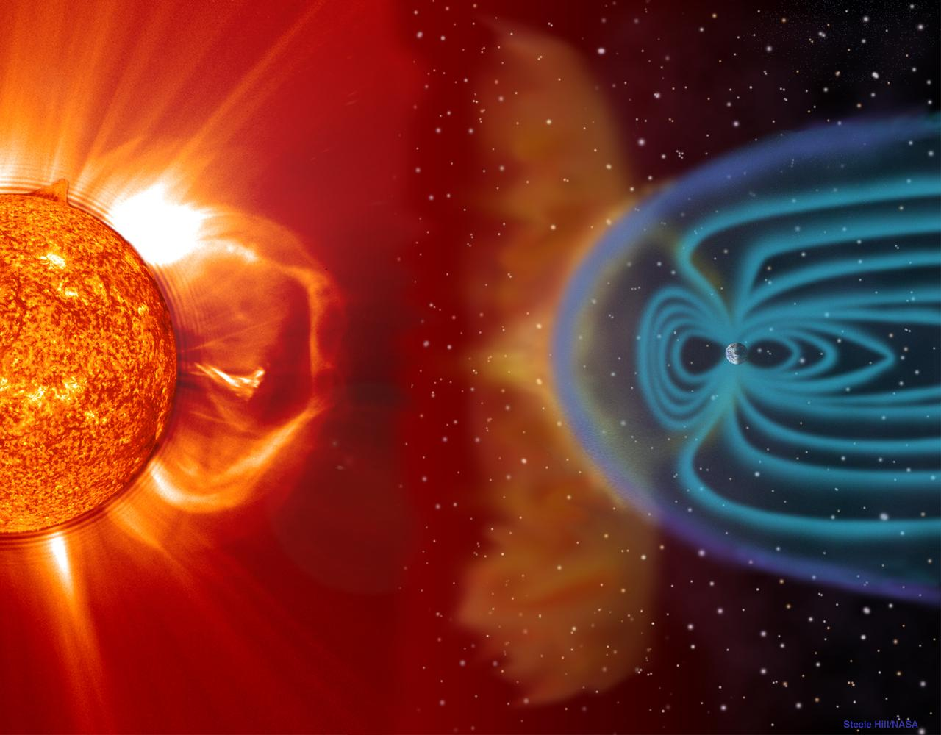
The CME hurtles away from the Sun. At this point it's called an ICME (Interplanetary CME).
These structures are 200 times the Sun's radii (the picture of the right is very out of scale!)
True scale (44:20)
Solar Energetic Particles (SEPs) get accelerated up to relativistic speeds. These can penetrate the Earth's magnetic field and atmosphere.
You'll explore at the effects of these particles on satellites, GPS and aircraft later this week.

Slide 8
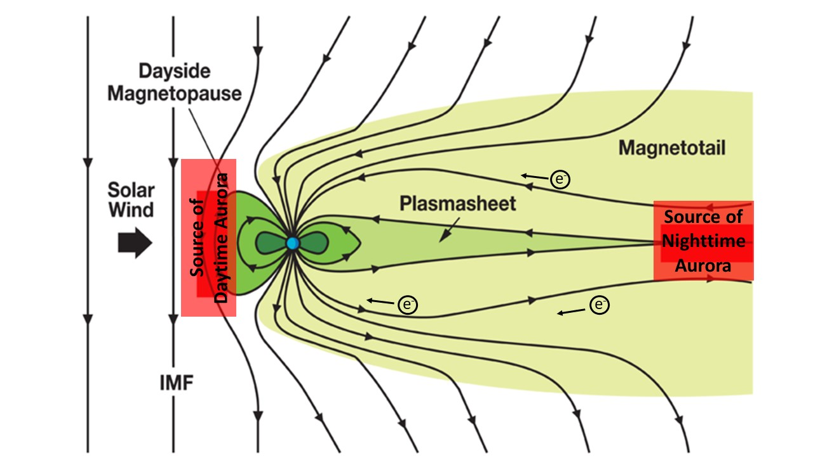
The Earth also has a magnetic field.
Magnetic reconnection of the magnetic field of the CME and the Earth happens at the front of the Earth's magnetic field.
The Dungey Process describes how the Earth's magnetic field responds to CME impacts.
Acceleration processes on the magnetotail of the Earth causes particles to hurtle towards Earth with lots of energy.
These drive complex Geomagnetic Storms.
You'll explore the effects of space weather on the Earth later this week.

Slide 9
These drive the aurora.

Slide 10
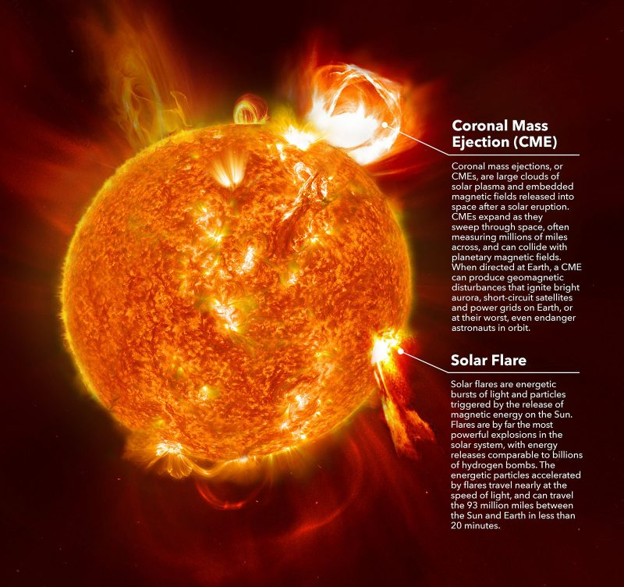
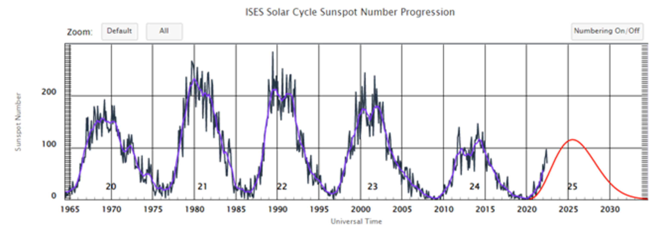

Slide 11
Understanding Solar Activity When’s the best time to explore?
The sun has a ‘solar cycle’ – a cycle in which is it more and less active.
Can you determine the length of a cycle from the data?
Which solar events (SEP, Flare, CME) most closely track the solar cycle? Why? [Why is there a solar cycle at all?]
What about energy of these events? Does it increase at solar maximum?

Slide 12
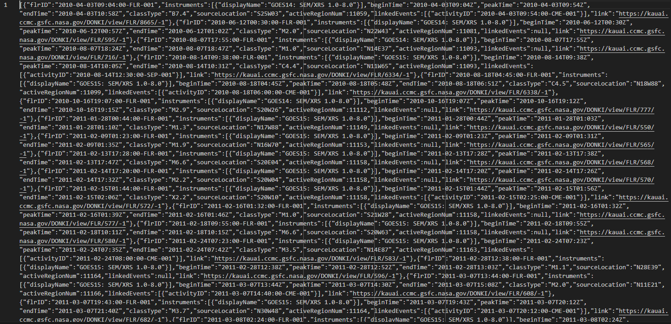
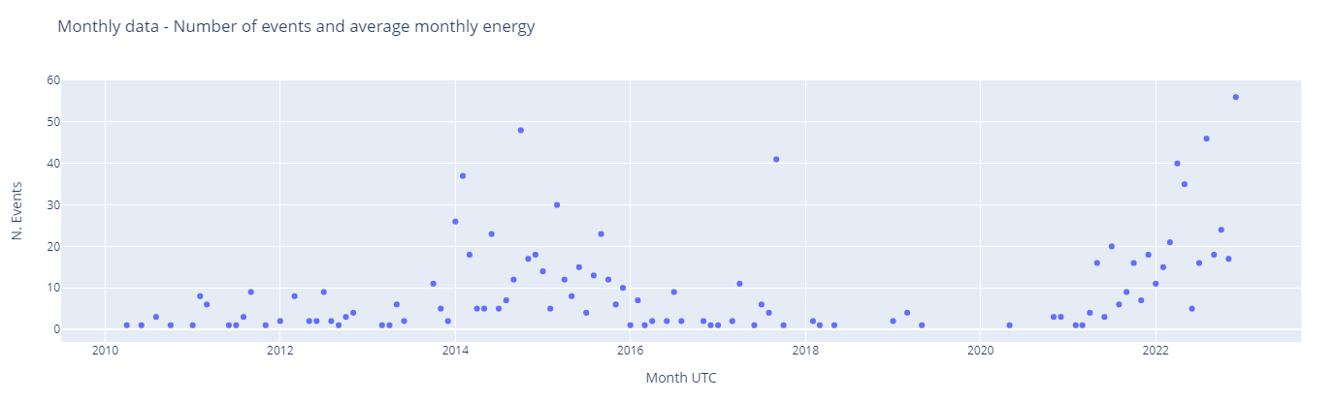

Slide 13
Plasma from the Sun to Earth What are the dangers we need to avoid?
Find a solar flare and see if you can find the associated CME, SEP and Storm. What are the timescales between these processes?
Start by choosing an extreme (X class) solar flare. You may wish to research which the biggest recent ones are.
Track the CME associated with it.
Could you find the SEP and Geomagnetic Storm?
Extension: find the belt enhancement and shock. Are there any other processes to track?
What are the timescales of the processes? (e.g. time from CME to Geomagnetic Strom)

Slide 14
Plasma from the Sun to Earth What are the dangers we need to avoid?
Research Qn: What are the dangers to life as we know it at home?​
On Friday afternoon, you'll have a 'workshop' where you inform an interested official of some of the dangers.​
It's not a presentation, but a technical chat where you let them know the dangers.​
To start you off, here's the UK Risk Register, which details some of the planning for emergency events:
2020 UK risk register (page 33)

Slide 15
Identify Habitable Exoplanets Where next?
What is life?
What are the stellar/planetary characteristics to support life?
Identify candidate planets in Kepler data
You'll present this research piece on Thursday afternoon.
Include all the relevant background info
Include how you've gone about the research
Include the results
Include what you think the next interesting steps are. Mission to Mars, anyone?

Slide 16
What makes a planet habitable? 'It's dead easy... just 1/r² and divide through by Earth'
Planet mass to semi-major axis ratio to keep atmosphere/ magnetic field presence (radiation protection)
Semi-major axis & eccentricity ( habitable zone – right temp & not tidally locked – no temp flux)
Stellar classification (temp, radiation env and longevity of system – time for life to ‘emerge’)
Mass of planet ( <10 Earth) & radius of planet (1-2 Earth) (‘rocky’ for carbon)

